Slide 1

Web Development & Design Foundations with HTML5
Tenth Edition
Chapter 3
Configuring Color and Text with CSS
Copyright © 2021, 2019, 2017 Pearson Education, Inc. All Rights Reserved

Slide 2
Learning Outcomes (1 of 2)
In this chapter, you will learn how to . . .
Describe the evolution of style sheets from print media to the Web
List advantages of using Cascading Style Sheets
Use color on web pages
Create style sheets that configure common color and text properties
Apply inline styles
Use embedded style sheets

Slide 3
Learning Outcomes (2 of 2)
Use external style sheets
Configure element, class, id, and contextual selectors
Utilize the “cascade” in CSS
Validate CSS

Slide 4
Overview of Cascading Style Sheets (CSS)
See what is possible with CSS:
Visit http://www.csszengarden.com
Style Sheets
used for years in Desktop Publishing
apply typographical styles and spacing to printed media
CSS
provides the functionality of style sheets (and much more) for web developers
a flexible, cross-platform, standards-based language developed by the W3C.

Slide 5
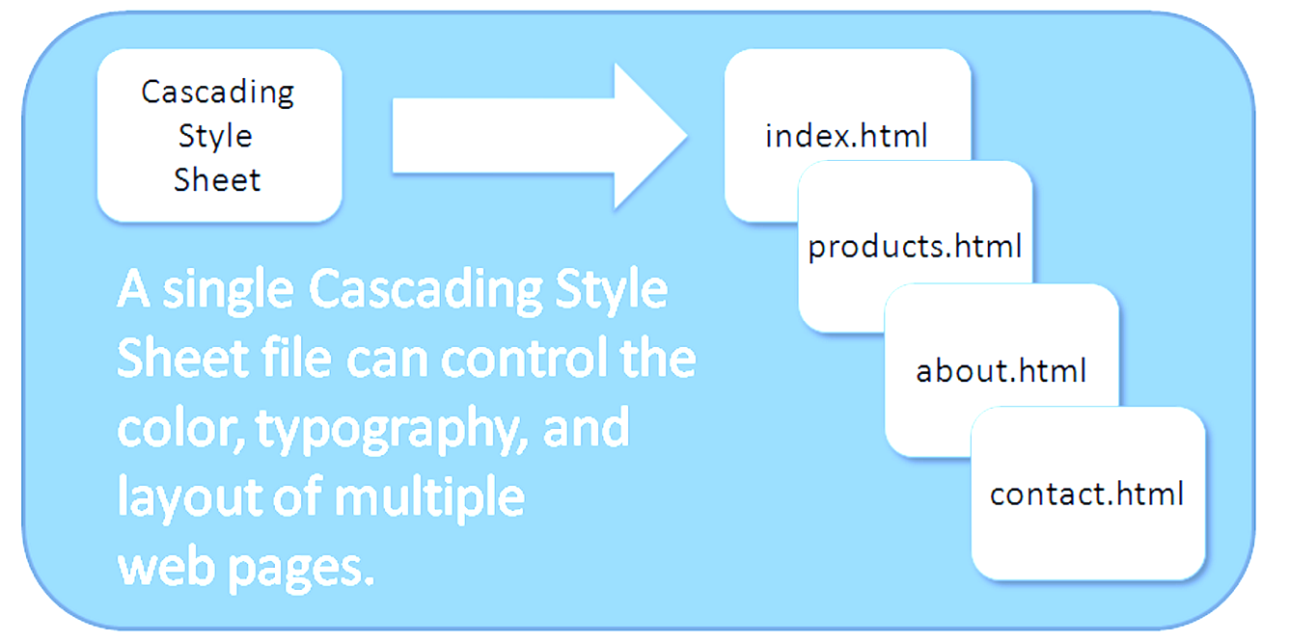
Figure 3.1 The power of a single CSS file

Slide 6
CSS Advantages
Greater typography and page layout control
Style is separate from structure
Styles can be stored in a separate document and associated with the web page
Potentially smaller documents
Easier site maintenance

Slide 7
Types of Cascading Style Sheets
Inline Styles
Embedded Styles
External Styles
Imported Styles

Slide 8
Cascading Style Sheets (1 of 2)
Inline Styles
body section
HTML style attribute
apply only to the specific element
Embedded Styles
head section
HTML style element
apply to the entire web page document

Slide 9
Cascading Style Sheets (2 of 2)
External Styles
Separate text file with .css file extension
Associate with a HTML link element in the head section of a web page
Imported Styles
Similar to External Styles
We’ll concentrate on the other three types of styles.

Slide 10
CSS Syntax
Style sheets are composed of “Rules” that describe the styling to be applied.
Each Rule contains a Selector and a Declaration

Slide 11

Figure 3.2 Using CSS to set the text color to blue

Slide 12
CSS Syntax Sample
Configure a web page to display blue text and yellow background.
body { color: blue;
background-color: yellow; }
This could also be written using hexadecimal color values as shown below.
body { color: #0000FF;
background-color: #FFFF00; }

Slide 13
Common Formatting CSS Properties
See Table 3.1 Common CSS Properties, including:
background-color
color
font-family
font-size
font-style
font-weight
line-height
margin
text-align
text-decoration
width

Slide 14
Using Color on Web Pages
Computer monitors display color as intensities of red, green, and blue light
RGB Color
The values of red, green, and blue vary from 0 to 255.
Hexadecimal numbers (base 16) represent these color values.

Slide 15
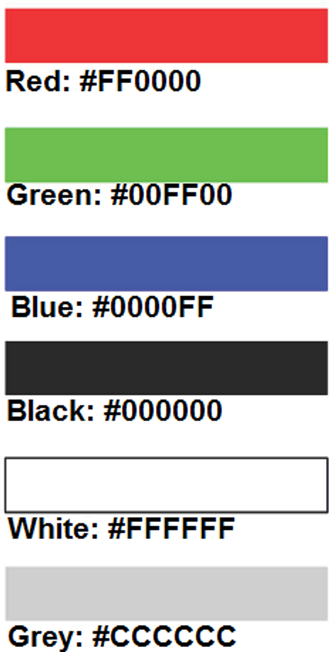
Figure 3.4 Color swatches and hexadecimal color values

Slide 16
Hexadecimal Color Values
# indicates a hexadecimal value
Hex value pairs range from 00 to FF
Three hex value pairs describe an RGB color
#000000 black #FFFFFF white
#FF0000 red #00FF00 green
#0000FF blue #CCCCCC grey

Slide 17
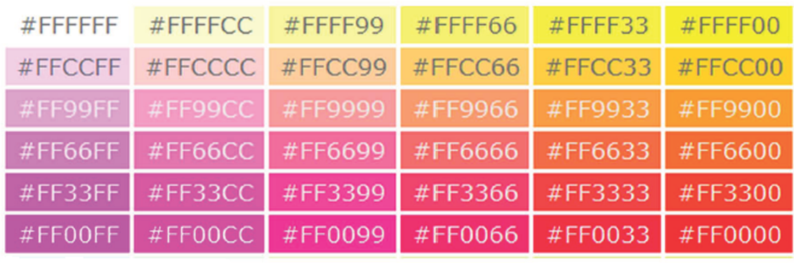
Figure 3.5 Partial color chart

Slide 18
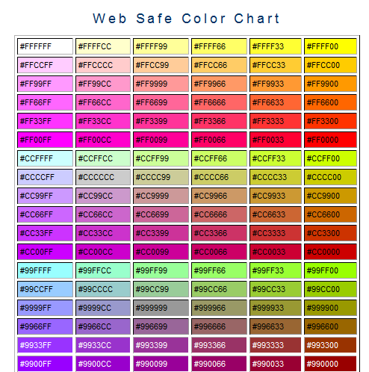
Web Color Palette
A collection of 216 colors
Display the most similar on the Mac and PC platforms
Hex values: 00, 33, 66, 99, CC, FF
Color Chart http://webdevfoundations.net/color
Source: http://webdevfoundations.net/color

Slide 19
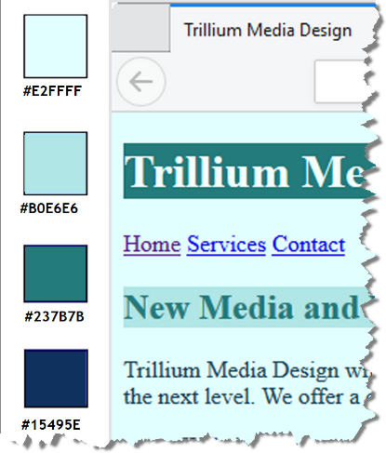
Making Color Choices
How to choose a color scheme?
Monochromatic
http://meyerweb.com/eric/tools/color-blend
Choose from a photograph or other image
http://www.colr.org
Begin with a favorite color
Use one of the sites below to choose other colors
http://colorsontheweb.com/colorwizard.asp
https://color.adobe.com/create/color-wheel
http://paletton.com

Slide 20
Support Web Accessibility Verify Sufficient Contrast
When you choose colors for text and background, sufficient contrast is needed so that the text is easy to read.
Use one of the following online tools to verify contrast:
http://webaim.org/resources/contrastchecker
http://snook.ca/technical/colour_contrast/colour.html
http://juicystudio.com/services/luminositycontrastratio.php

Slide 21

Configuring Color with Inline CSS
Inline CSS
Configured in the body of the web page
Use the style attribute of an HTML tag
Apply only to the specific element
Example: configure red color text in an <h1> element:
<h1 style="color:#ff0000">Heading text is red</h1>

Slide 22
Configuring Color with Inline CSS (2)
Example 2: configure the red text in the heading
configure a gray background in the heading
Separate style rule declarations with a ; symbol
<h1 style="color:#FF0000;background-color:#cccccc">This is displayed as a red heading with gray background</h1>

Slide 23
CSS Embedded (Internal) Styles
Configured in the head section of a web page.
Use the HTML <style> element
Apply to the entire web page document
Style declarations are contained between the opening and closing <style> tags
Example: Configure a web page with white text on a black background
<style>
body { background-color: #000000;
color: #FFFFFF;
}
</style>

Slide 24
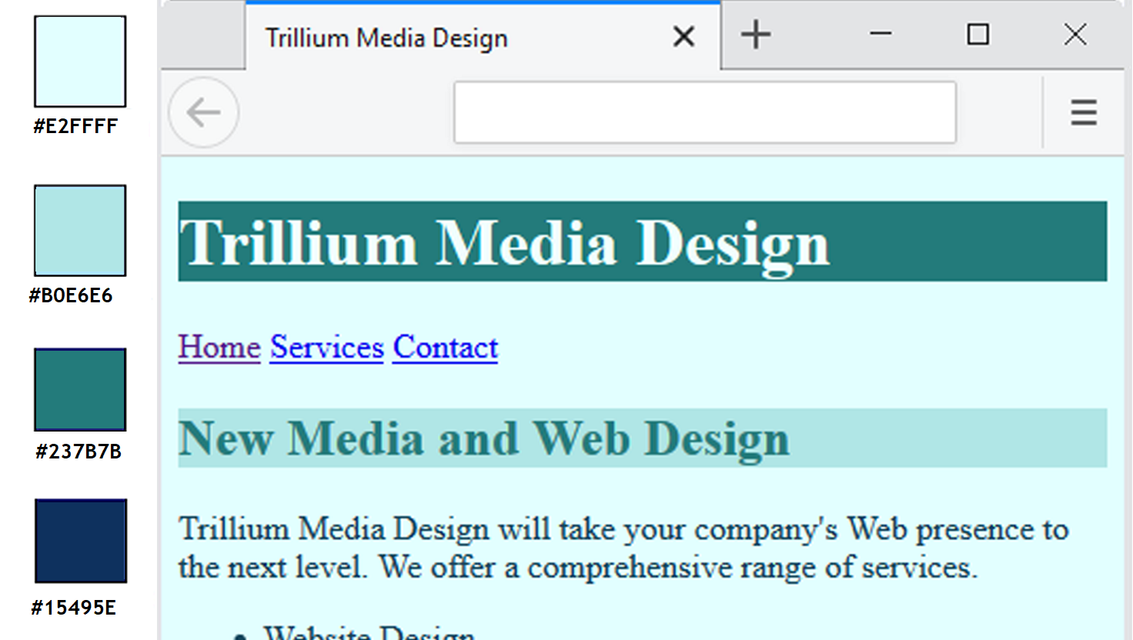
Figure 3.10 The web page after embedded styles are configured

Slide 25
CSS Embedded Styles
The body selector sets the global style rules for the entire page.
These global rules are overridden for <h1> and <h2> elements by the h1 and h2 style rules.
<style>
body { background-color: #E2FFFF;
color: #15495E;}
h1 { background-color: #237B7B;
color: #E2FFFF;}
h2 { background-color: #B0E6E6;
color: #237B7B;}
</style>

Slide 26
Checkpoint 3.1
List three reasons to use CSS on a web page.
When designing a page that uses colors other than the default colors for text and background, explain why it is a good reason to configure style rules for both text color and background color.
Describe one advantage to using embedded styles instead of inline styles.

Slide 27
Configuring Text with CSS
CSS properties for configuring text:
font-weight
Configures the boldness of text
font-style
Configures text to an italic style
font-size
Configures the size of the text
font-family
Configures the font typeface of the text

Slide 28
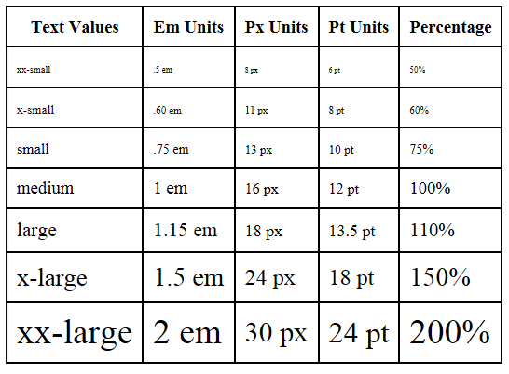
The font-size Property
Accessibility Recommendation: Use em or percentage font sizes–these can be easily enlarged in all browsers by users

Slide 29
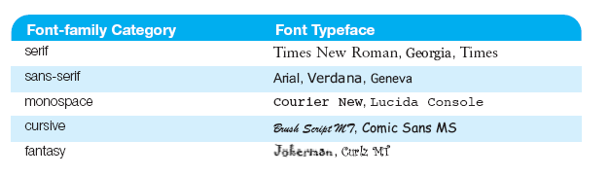
Figure 3.11 Common fonts

Slide 30
The font-family Property
Not everyone has the same fonts installed in their computer
Configure a list of fonts and include a generic family name
p { font-family: Arial, Verdana, sans-serif; }

Slide 31

Figure 3.14 CSS configures color and text properties on the web page

Slide 32
Embedded Styles Example
<style>
body { background-color: #E2FFFF; color: #15495E;
font-family: Arial, Verdana, sans-serif; }
h1 { background-color: #237B7B; color: #E2FFFF;
line-height: 200%;
font-family: Georgia, "Times New Roman", serif;
text-indent: 1em;
text-shadow: 3px 3px 5px #000000; }
h2 { background-color: #B0E6E6; color: #237B7B;
font-family: Georgia, "Times New Roman", serif;
text-align: center; }
nav { font-weight: bold;
font-size: 1.25em;
word-spacing: 1em; }
p { font-size: .90em; text-indent: 3em; }
ul { font-weight: bold; }
</style>

Slide 33
More CSS TEXT Properties (1 of 2)
line-height
Configures the height of the line of text (use the value 200% to appear double-spaced)
text-align
Configures alignment of text within a block display element
text-indent
Configures the indentation of the first line of text
text-decoration
Modifies the appearance of text with an underline, overline, or line-through

Slide 34
More CSS TEXT Properties (2 of 2)
text-transform
Configures the capitalization of text
letter-spacing
Configures space between text characters
word-spacing
Configures space between words
text-shadow
Configures a drop shadow on text

Slide 35
CSS Selectors
CSS style rules can be configured for an:
HTML element selector
class selector
id selector
descendant selector

Slide 36
Using CSS with “class”
<style>
.new { color: #FF0000;
font-style: italic;
}
</style>
class Selector
Apply a CSS rule to a certain “class” of elements on a web page
Does not associate the style to a specific HTML element
Configure with .classname
code CSS to create a class called “new” with red italic text.
Apply the class:
<p class=“new”>This is text is red and in italics</p>

Slide 37
Using CSS with “id”
<style>
#new { color: #FF0000;
font-size:2em;
font-style: italic;
}
</style>
id Selector
Apply a CSS rule to ONE element on a web page.
Configure with #idname
Code CSS to create an id called “new” with red, large, italic text.
Apply the id: <p id=“new”>This is text is red, large, and in italics</p>

Slide 38
CSS Descendant Selector
Specify an element within the context of its container (parent) element.
AKA contextual selector
The example configures a green text color only for p tags located within an element assigned to the id named content
Advantage of contextual selectors: Reduces the number of classes and ids you need to apply in the HTML
<style>
#content p { color: #00ff00; }
</style>

Slide 39
span element
Purpose:
configure a specially formatted area displayed in-line with other elements, such as within a paragraph.
There is no additional empty space above or below a span – it is inline display.

Slide 40
span Element Example
Embedded CSS: <style>
.companyname { font-weight: bold;
font-family: Georgia, “Times New Roman”, serif;
font-size: 1.25em; }
</style>
HTML:
<p>Your needs are important to us at <span class=“companyname” >Acme Web Design</span>. We will work with you to build your website.</p>
Your needs are important to us at Acme Web Design. We will work with you to build your website.

Slide 41
External Style Sheets - 1
CSS style rules are contained in a text file separate from the HTML documents.
The External Style Sheet text file:
extension “.css”
contains only style rules
does not contain any HTML tags

Slide 42
External Style Sheets - 2
Multiple web pages can associate with the same external style sheet file.
site.css
index.html
body {background-color:#E6E6FA;
color:#000000;
font-family: Arial, sans-serif;
font-size:90%; }
h2 { color: #003366; }
nav { font-size: 16px;
font-weight: bold; }
clients.html
about.html
Etc…

Slide 43
link Element
A self-contained tag
Placed in the head section
Purpose: associates the external style sheet file with the web page.
Example:
<link rel=“stylesheet” href=“color.css”>

Slide 44
Using an External Style Sheet
External Style Sheet color.css
body { background-color: #0000FF;
color: #FFFFFF;
}
To associate the external style sheet called color.css, the HTML code placed in the head section is:
<link rel=“stylesheet” href=“color.css”>

Slide 45
Checkpoint 3.2
Describe a reason to use embedded styles. Explain where embedded styles are placed on a web page.
Describe a reason to use external styles. Explain where external styles are placed and how web pages indicate they are using external styles.
Write the code to configure a web page to use an external style sheet called “mystyles.css”.

Slide 46
Centering Page Content with CSS
#container { margin-left: auto;
margin-right: auto;
width: 80%; }

Slide 47

Figure 3.23 The page content is centered within the browser viewport

Slide 48
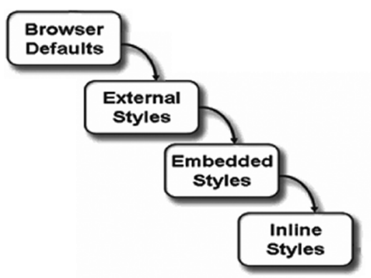
Figure 3.24 The “cascade” of Cascading Style Sheets

Slide 49
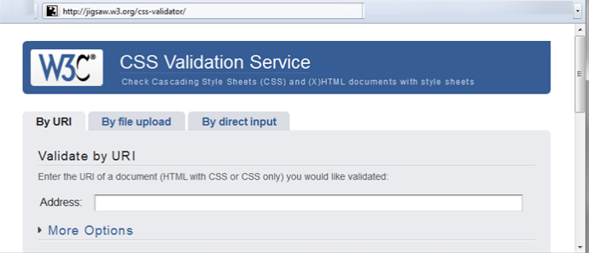
W3C CSS Validation
http://jigsaw.w3.org/css-validator/
Partial screenshot of http://jigsaw.w3.org/css-validator

Slide 50
Summary
This chapter introduced you to Cascading Style Sheet Rules associated with color and text on web pages.
You configured inline styles, embedded styles, and external styles.
You applied CSS style rues to HTML, class, id, and descendent selectors.
You are able to submit your CSS to the W3C CSS Validation test.

